Slide 1
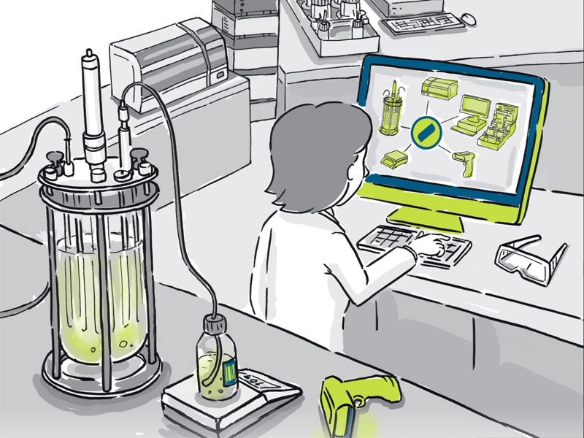
BIOPROCESS TECHNOLOGY (MBT-303)
Prof. R.K.Gaur

Slide 2
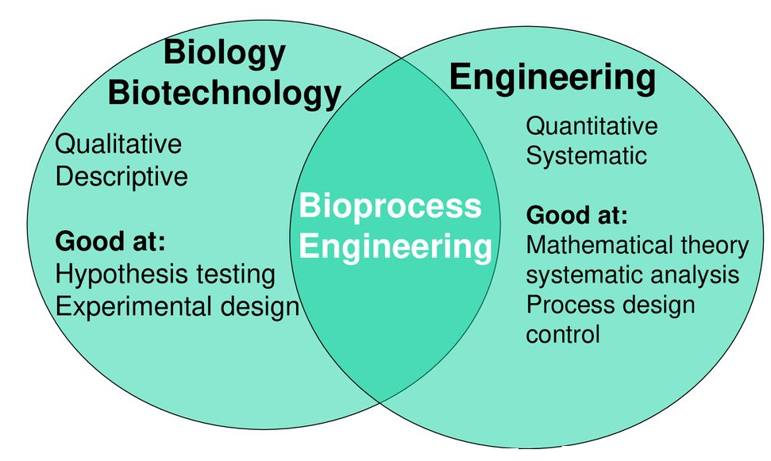
Introduction
Fields of study:
Biology, engineering, bio-engineering, medicine, genetic
engineering, molecular biology
Interdisciplinary
sciences:
combines the disciplines
of biology & engineering
Commercial exploitation of the living things on a large scale

Slide 3
Keywords used
Biomass
Bioreactor
Bioremediation
Enzymes
Fermentation
Fermenter
Definition: Use of engineering devices in biological process carried out
by living organisms or cells in order to improve or analyze the process.
Having an important role in industries including food, microbiological,
pharma, chemical and biotechnological

Slide 4
HISTORY
10,000-7,000 BC Wine making developed in Eastern
Mediterranean.
7,000-5,000 BC Beer developed in Egypt and Babylon.
5.000 BC Cheese making and some medicinal
plants were developed.
4,000 BC Vinegar was referenced in old testament.
500 AD Algae was cultivated for food by Aztecs.
500 AD Yogurt, sauces and fermented meats were developed.
1600 AD The name fermentation was used.
Notes:
History

Slide 5
1680 AD Van Leeuwenhoek observed yeast cells
in alcohol fermentation.
1781 AD Pressed Baker’s yeast produced by Dutch
(this was the first improvement process
in handling Baker’s yeast).
1789 AD Jenner demonstrated vaccination against
smallpox infection (First immunization).
1837 AD Cagniard-Latour, Schwann and Kutzing
independently hypothesized that yeast is a
living thing. (First knowledge on cell
biology).

Slide 6
1847 AD Blondeau studied fermentation of lactic acid,
butyric acid, acetic acid and urea. He
hypothesized that different fermentations
carried out by different organisms (fungi?).
1857 AD Pasteur demonstrated that living yeast cells
ferment sugar into ethanol and carbon dioxide
Pasteur noted cylindrical organisms produce
butyric acid only in absence of oxygen.
(First knowledge on anaerobic fermentation).
1859 AD Darwin published the Origin of Species.
1877 AD Pasteur noted relationship between
microbes / infectious disease. (First knowledge
on pathogenic organisms).

Slide 7
1881 AD Koch developed methods for handling
microbial cultures (First knowledge on
microbial technique and maintenance).
1881 AD First commercial production of lactic acid
by anaerobic fermentation.
1894 AD Takamine patented a process to isolate
diastase enzymes from molds that can break down starch. (First knowledge on
enzymes it’s applications).
1916 AD Germany produces baker’s yeast grown on
molasses as protein supplement. Also,
produced glycerol by yeast fermentation.

Slide 8
1918 AD Great Britain produced acetone and butanol
by anaerobic fermentation process.
1923 AD Commercial production of citric acid by
surface cultures.
1929 AD Fleming demonstrated that mold
contaminant in a petri-dish causes bacterial
death. (Fist discovery of microbial antibiotics)
1934 AD Gautheret successfully cultured plant cells.
(First knowledge on plant tissue culture).
1940 AD Florey and Chain isolated penicillin, elucidated
its structure and demonstrated its bacterial
properties on G(+) bacteria.

Slide 9
1940s Waxman discovered streptomycin's. and its
properties on G(-) bacteria (first microbial
screening method for new antibiotics discovery)
Waxman also discovered vitamin B12.
1950s The production of Cortisone at the cost of
$200/g (now it’s cost is $16/g).
The production of polio and peruses vaccines.
1960s The production of Xanthus gum.
The production of alkine protease for
detergents industry.
1970s The discovery of glucose isomerase and the
production of high fructose corn syrup (HFCS)
as a sweetener.

Slide 10
1970s Human growth hormone was synthesized.
The development of recombinant human
insulin.
1980s Kohler and Milstein developed monoclonal
antibodies.
The production of poly (hydroxybutyrate).
US Supreme Court approved the principle of
patenting organisms.
First recombinant DNA vaccine for livestock.
FDA approved Insulin drug.
Interferon the first anticancer drug.
The first pest resistant corn (Bt corn).
FDA approve the first hepatitis C vaccine.
The first transgenic animals

Slide 11
1990s The production of amino acids (lysine,
threonine and isoleucine).
The production of antibodies.
The discovery of first breast cancer gene.
The discovery of gene associated with
Parkinson's disease.
A sheep named Dolly become the first animal
cloned from an adult cell.
FDA approved bovine (BST) for dairy cows.
The commercialization of first genetically
engineered corps.
The first gene therapy for immune disorder.

Slide 12
2000s The production 1,2-propandiol.
The production of xylitol
The production of hydroxpropanoic acid.
FDA approved the first gene target for patient
with chronic myeloid leukemia.
FDA approved the first transgenic rootworm
resistant corn.
Sequencing human genome.
FDA approved the first anti-angiogenic drug for
cancer.
FDA approved the recombinant HPV vaccine.
FDA approved the first H₅N₁ avian flue vaccine.

Slide 13
2000s FDA approved the first transgenic animal for
the production of human recombinant anti-
thrombine.
USDA granted the first regulatory for a plant
made vaccine.
Global biotechnology crops reaches over 330
million acres.
2010s The creation of first synthetic cell.
Advances in stem cell technology.
Advances in 3-D printing technology leading
to skin printing.
& many more till date

Slide 14
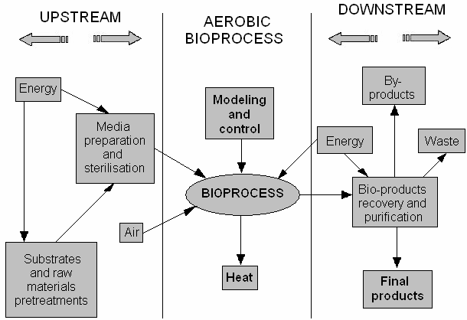
How it works

Slide 15
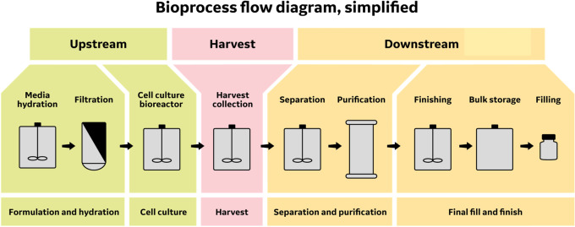
Bioprocess components

Slide 16
Component parts of a fermenter
Formulation of media to be used in culturing the organism during development of inoculum and in the production fermenter
Sterilization of the medium, fermenter and ancillary equipment
Production of an active, pure culture in sufficient quantity to inoculate the production vessel
The growth of the organism in the production fermenter under optimum conditions for product formation
The extraction of the product and its purification
Disposal of effluents produced by the process

Slide 17
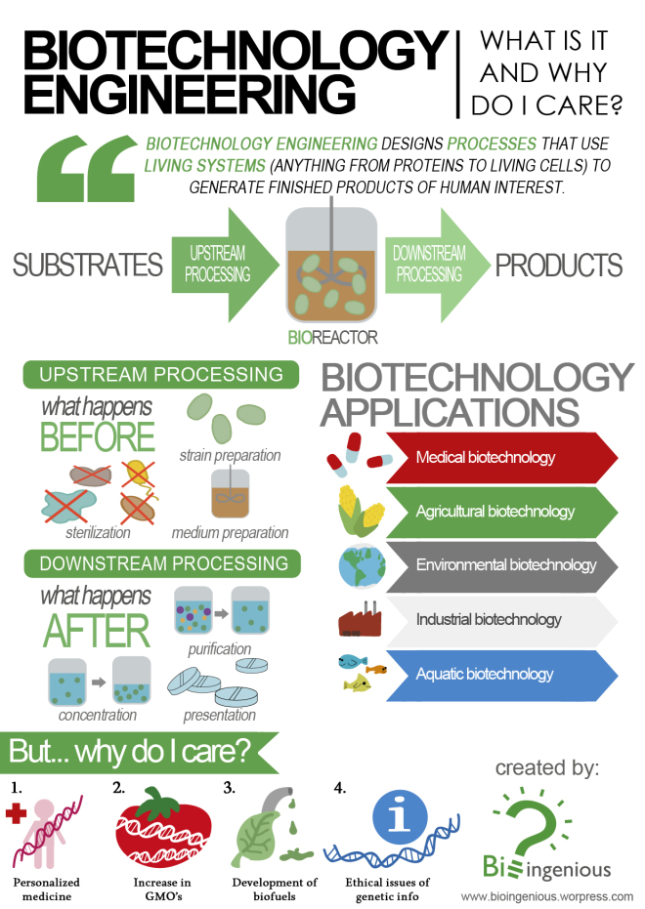

Slide 18
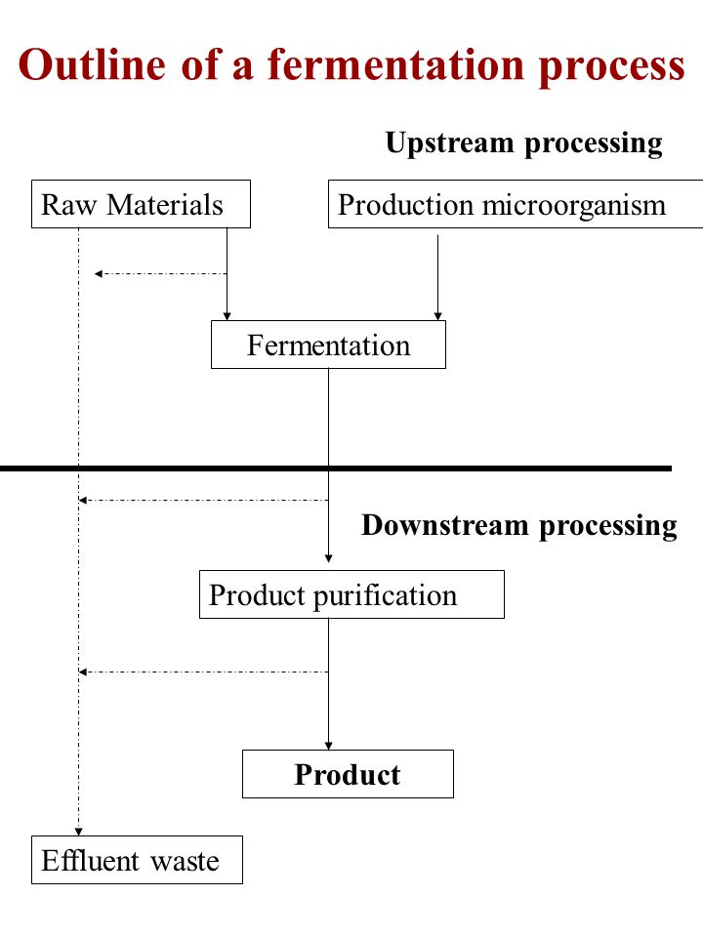
Introduction
Parts of fermentation process
Fermentation process may be divided in six basic components
Formulation of media
Sterilization of the medium
Production of an active pure culture
Growth of the organism
Extraction of the product
Disposal of effluents
Notes:
Established fermentation process may be divided in six basic components

Slide 19
Fermentation (Process): typically refers to the fermentation of sugar to alcohol using yeast, but other fermentation processes include making of yogurt, souring of milk, rising of dough
Bioreactor: An apparatus (usually jacketed cylindrical SS vessel) for growing organisms such as bacteria, viruses, or yeast that are used in the production of pharmaceuticals, antibodies, or vaccines, or for the bioconversion of organic wastes

Slide 20
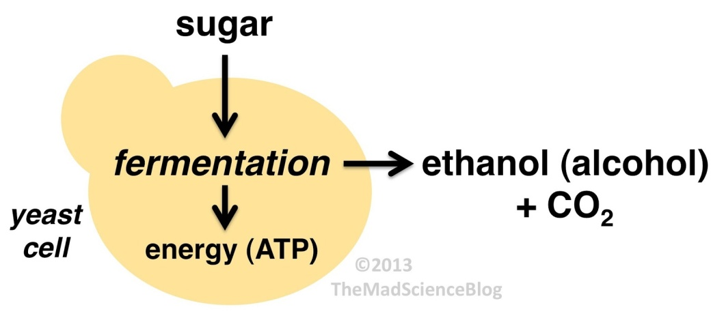
Fermentation Meaning
Biochemical Process
Industrial Microbiology

Slide 21
Fermentation Processes can be classify into five different categories
1. Processes Producing Microbial Enzymes
2. Processes Producing Microbial Metabolites
3. Processes Producing Microbial Cells (Biomass) as the Products
4. Processes Producing Recombinant Products
5. Processes modifying Substrates (Transformation Process)

Slide 22
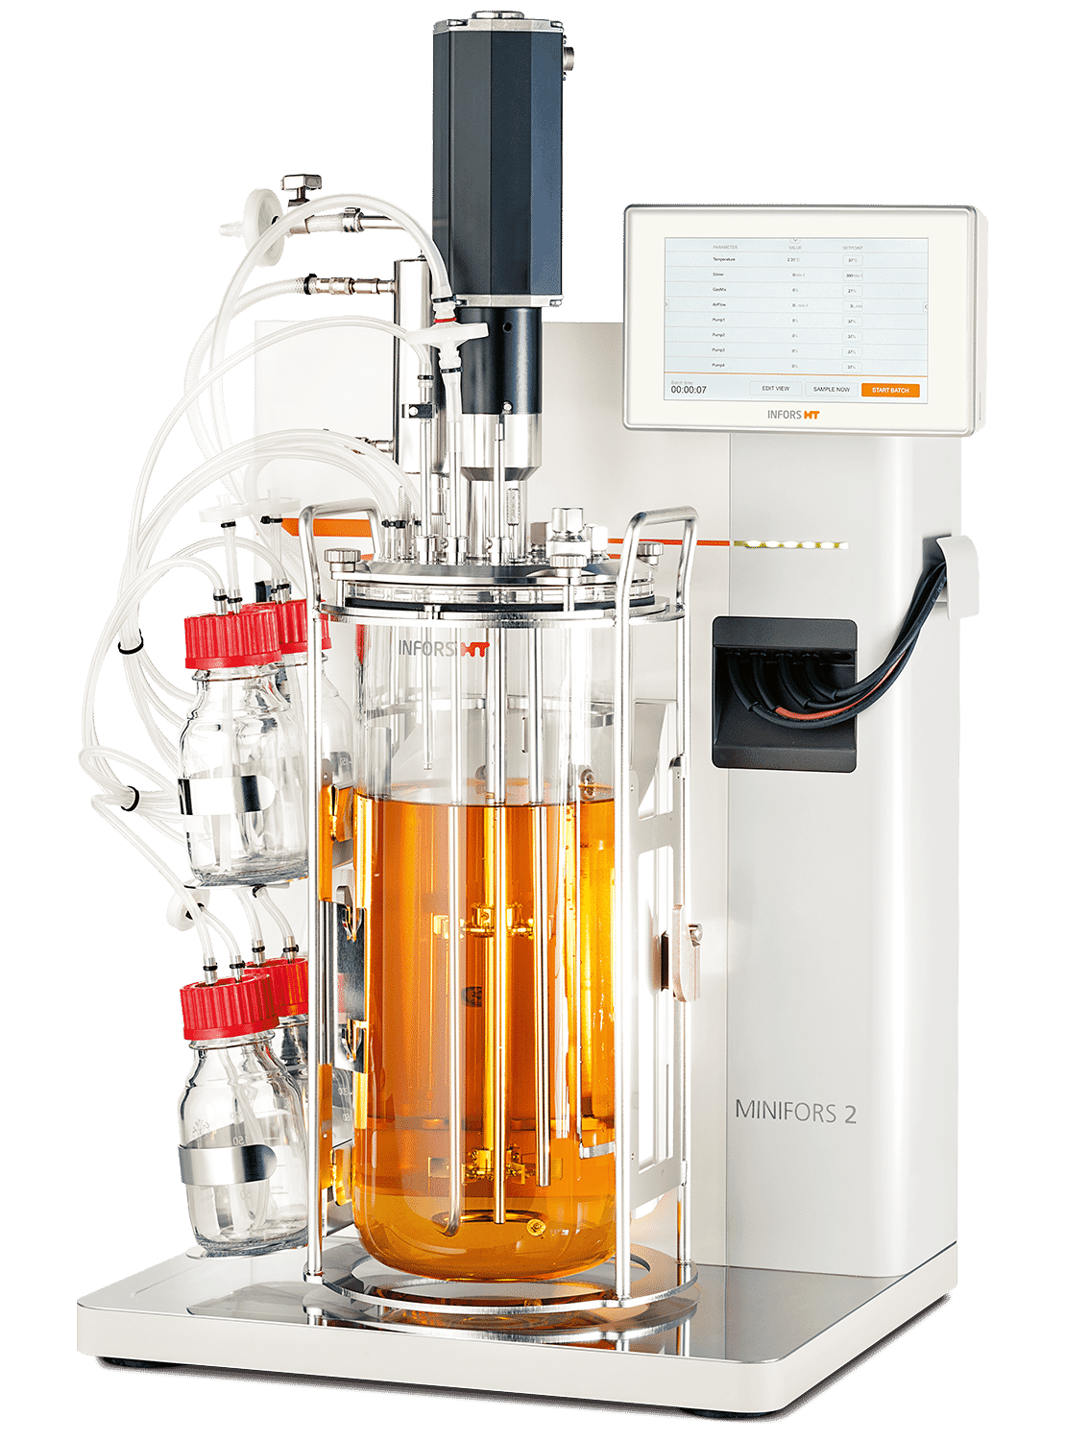
What is bioreactor
An apparatus for growing organisms (yeast, bacteria, or animal cells) under controlled conditions
used to convert raw materials into useful byproducts
Bioreactor basics
Systems or devices that supports a biologically active environment
Vessels in which a chemical process is carried out which involves
organisms or biochemically active substances derived from such organisms
aerobic or anaerobic
Cylindrical, ranging in size from liters to cubic meters, and are often made of stainless steel
homogeneous (same throughout) environment by constantly stirring the contents.
Give the cells a controlled environment by ensuring the same temperature, pH, and oxygen levels.

Slide 23
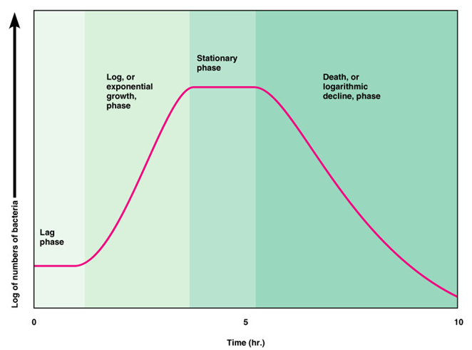
Considerations in bioreactor design
Oxygenation for aerobic microorganisms
Temperature management
Methods for monitoring the culture
Sterility

