Slide 1
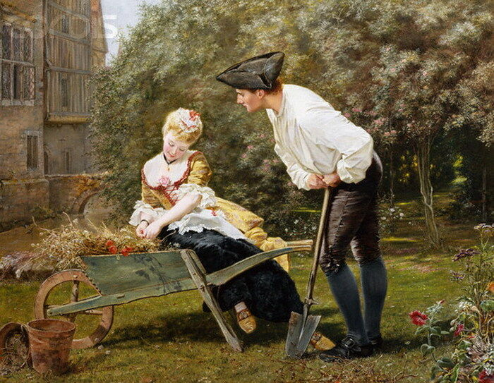
To His Coy Mistress

Slide 2
To His Coy Mistress
To His Coy Mistress" is a Cavalier poem written by the English author and politician Andrew Marvell (1621–1678) either during or just before the English interregnum (1649–60). It was published posthumously in 1681.

Slide 3
This poem is considered one of Marvell's finest and is possibly the best recognised carpe diem poem in English. Although the date of its composition is not known, it may have been written in the early 1650s. It’s a classic seduction poem

Slide 4
The poet opens by telling his mistress that, given all the time in the world, he would spend hundreds of years praising each part of her body, while she could spend hundreds of years refusing his advances. But he gently reminds her that their mortal days are not so abundant and urges her to submit to his embraces before her beauty fades and they both die.

Slide 5
The poet’s argument is ingeniously constructed and presented, and the reader is left with both an amusing portrait of an impatient lover and a deeper sense of the evanescence of life.

Slide 6
To His Coy Mistress" is a carpe diem poem
it urges a young woman to enjoy the pleasures of life before death claims her. Indeed, the poem is an attempt to seduce the "coy mistress." In the process, however, the speaker dwells with grotesque intensity on death itself. Death seems to take over the poem, displacing the speaker's erotic energy and filling the poem with dread.

Slide 7
The term "carpe diem" means "seize the day"; or, less literally, "make the most out of the time we have." The phrase is often credited to the Roman poet Horace.
Marvell’s ‘To His Coy Mistress’ is built on ‘Crape-Dime’ theme. In his poem we find a lover more active in the courtship urges his lady-love to make love at her youth. The shy mistress remains always from the immediate response but the lover builds the logic of syllogism and concludes that the only way of courtship is enjoying life while ones are young.

Slide 8
The theme of Marvell’s poem ‘To His Coy Mistress’ is traditional as it is based on the love-time theme. The poet’s idea about the mortality of the world and the transience of love are reflected here. The famous Latin poet Catullus, Ben Johnson’s poem ‘Song to Celia’, Spenser in his sonnet no.75 from Amoretti, Shakespeare and a lot others celebrate the same theme.

Slide 9
Herrick’s well known lines may be quoted as a specific instance of Carpediem theme- “Gather ye rose buds while ye may,…then be not coy, but use your time.”The poet’s implication is that lovers must enjoy themselves in the prime of their youth in the world where time is ever fleeting.

Slide 10
The poem is written in Iambic tetrameter and rhymes in couplets. The first verse paragraph ("Had we...") is ten couplets long,
the second ("But...") six,
and the third ("Now therefore...") seven.
The logical form of the poem runs: if... but... therefore....
Syllogistic pattern

Slide 11
A syllogism is a form of logic in which a conclusion appears to be logically derived from two axiomatic propositions. It is a process in logic-a sort of deductive reasoning. It is a form of logic to deduce a conclusion from two given or assumed propositions.

Slide 12
For example, if one proposition is that airplanes contribute to global warming and a second proposition is that global warming is dangerous, then the logical conclusion is that we should all try to reduce the number of flights we take.

Slide 13
The poem is constructed like a syllogism in the form of reasoning to deduce the main contention. This poem has three parts.
The first part comprising the first twenty lines contains the first proposition.
The next twelve lines constitute the second part, and it states the second proposition.
The conclusion is drawn from these two propositions in the remaining lines.

Slide 14
The thesis and the antithesis of the first two sections of the poem lead naturally to the synthesis- the crux of the carpe diem theme.

Slide 15
The poem is in iambic tetrameter, with eight syllables (four feet) per line. Each foot consists of an unstressed syllable followed by a stressed syllable. The last syllable of Line 1 rhymes with the last syllable of line 2, the last syllable of line 3 rhymes with the last syllable of line 4, the last syllable of line 5 rhymes with the last syllable of line 6, and so on.

Slide 16
Such pairs of rhyming lines are called couplets.
The following two lines, which open the poem, exhibit the meter and rhyme prevailing in most of the other couplets in the poem:
......1..................2...................3...............4
Had WE..|..but WORLD..|..e NOUGH..|..and TIME
.......1.......... ..2........... ....3...............4
This COY..|..ness LA..|..dy WERE..|..no CRIME

Slide 17
The poem does not present a scene in a specific place in which people interact. However, the young man and the young lady presumably live somewhere in England (the native land of the author), perhaps in northeastern England near the River Humber. The poet mentions the Humber in line 7.

Slide 18
Many authors have borrowed the phrase "World enough and time" from the poem's opening line to use in their book titles. The most famous is R P Warren’s 1950 novel World Enough and Time: A Romantic Novel, about murder in early-19th-century Kentucky.

Slide 19
The phrase "there will be time" occurs repeatedly in a section of T. S. Eliot's "The Love Song of J. Alfred Prufrock" (1915), and is often said to be an allusion to Marvell's poem.Prufrock says that there will be time "for the yellow smoke that slides along the street", time "to murder and create", and time "for a hundred indecisions ... Before the taking of a toast and tea". As Eliot's hero is, in fact, putting off romance and consummation, he is (falsely) answering Marvell's speaker.

Slide 20
Eliot also alludes to the lines near the end of Marvell's poem, "Let us roll all our strength and all / Our sweetness up into one ball", with his lines, "To have squeezed the universe into a ball / To roll it toward some overwhelming question," as Prufrock questions whether or not such an act of daring would have been worth it.

Slide 21
Eliot returns to Marvell in The Waste Land with the lines "But at my back in a cold blast I hear / The rattle of the bones" (Part III, line 185) and "But at my back from time to time I hear / The sound of horns and motors" (Part III, line 196).
The line "deserts of vast eternity" is used in the novel Orlando: A Biography, by Virginia Woolf, which was published in 1928.

Slide 22


Slide 23
References
Web Sources

