Slide 1
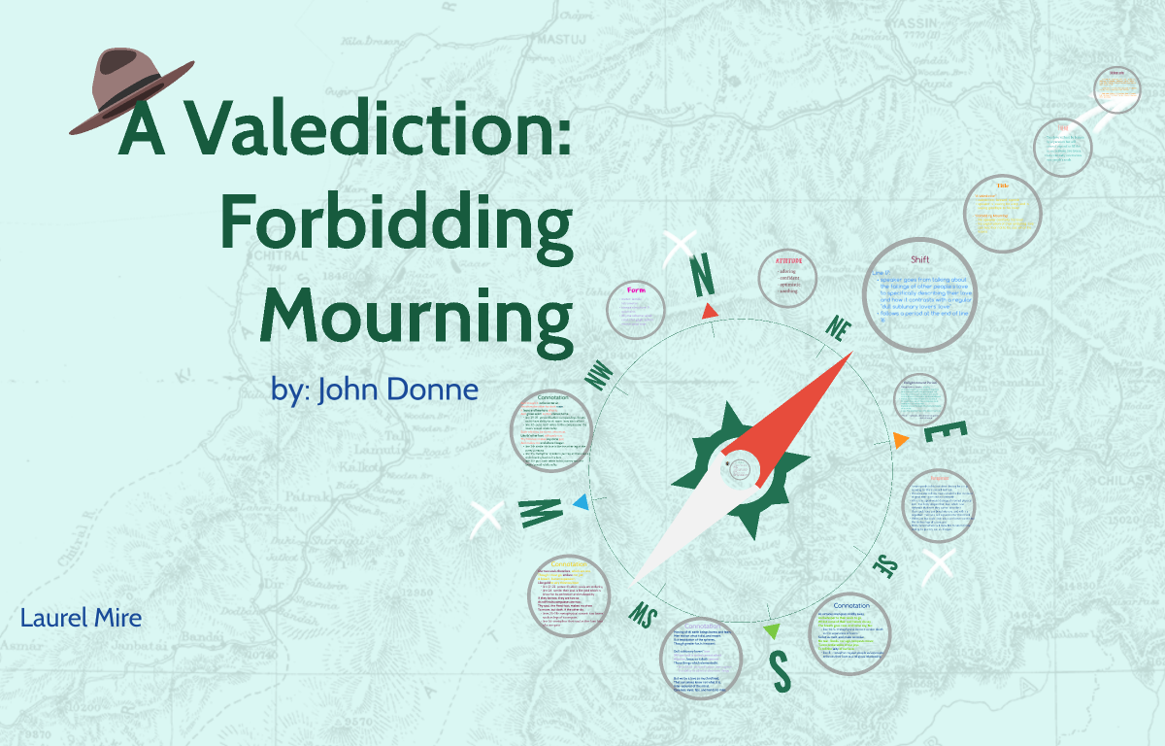

Slide 2
A valediction is a farewell. Donne's title, however, explicitly prohibits grief about saying goodbye (hence the subtitle of “Forbidden Mourning”) because the speaker and his lover are linked so strongly by spiritual bonds that their separation has little meaning.

Slide 3
About the Poem
Valediction is derived from Latin valedicare, meaning to bid farewell. According to Izaak Walton, Donne's biographer, the poem was addressed to his wife Anne More in 1611, while he was about to undertake a trip to France and Germany. The poem centres around spiritual love that transcends a carnal relationship.

Slide 4
He employs metaphysical conceits to a great extent in the poem, comparing their mutual love to a drawing compass. Although they are separated for a while, they are like the legs of the compass, united as a single being. The poem is superb in its celebration of spiritual love.

Slide 5
The poem is an argument. Donne had the education of a lawyer and was also a famous preacher so most things he wrote had a pretty strong logical, oratorical bent. His argument unfolds as a catalogue of bizarre comparisons.

Slide 6
He compares their love to dying old men, earthquakes, stars, gold, and a mathematical compass. It's tricky to follow, but comes together to form a perfect picture of love.Love, separation, and acceptance are the significant themes given in the poem.

Slide 7
The basic theme of the poem is the eternal togetherness of the souls of the lovers .Since their love is not confined to bodily contact, the separation of the bodies during the lover’s travels does not affect their union .The poem spells out the platonic conception of idea love

Slide 8
It is composed of nine four-line stanzas called quatrains each with an alternating ABAB rhyme scheme

Slide 9
The meter is iambic tetrameter, which may or may not mean anything to you at all. An iambic meter means that the syllables alternate between unstressed and stressed syllables. Tetrameter means that there are four stressed syllables per line.

Slide 10
Poem is replete with figures of speech. It begins with an extended Simile and proceeds to the metaphor of melting. In the second stanza, there is a hyperbolic reference to natural disasters, which may break a journey suggesting that, if the lovers indulge in weeping and lamentation, it will disturb the traveller’s mental balance.

Slide 11
Donne and other metaphysical poets are very fond of making exaggerated statements. The contrast between higher and lower love is exemplified by reference to cosmological processes. The expansion of true love is compared to gold beaten into thin sheet. Gold, associated with preciousness and elasticity, becomes an appropriate symbol of higher love.

Slide 12
When we consider the theme, imagery and meter of this poem we witness a remarkable correspondence. We are able to see that the poem is emotionally and aesthetically a superb piece of poetry.

Slide 13
References
        WEBSOURCES

