Slide 1
Oceanography II: Temperature & Salinity
Dr. Swarnima Singh
Dept of Geography
DDUGU

Slide 2
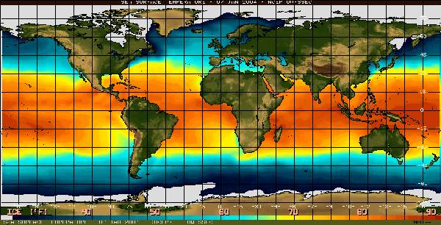
Variations in temperature:
From north to south due to the Sun’s radiation

Slide 3
Changes in the Sun’s angle cause variations in the amount of solar energy reaching Earth’s surface.

Slide 4
Variations in Sun’s rays with latitude

Slide 5
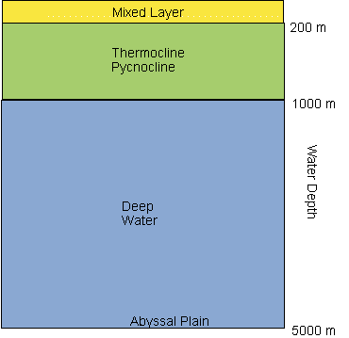
Layers of the Ocean: what determines the ocean’s layers?

Slide 6
Temperature: warmer at equator cooler near the poles
Surface temperature variations

Slide 7
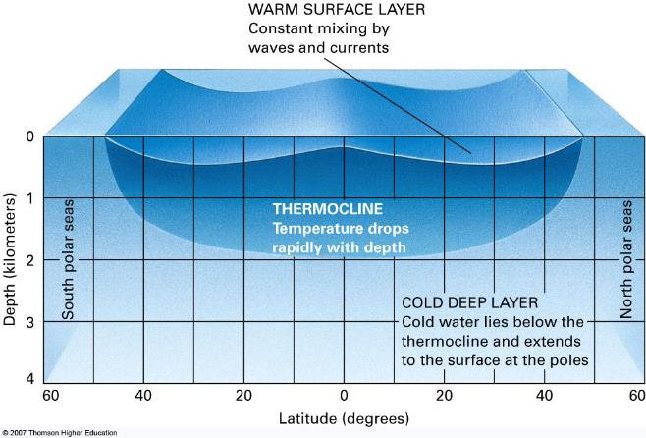
Temperature variations within ocean basins: sketch and describe
Ocean basins

Slide 8
Salinity of Seawater
Water is bipolar
The cation sodium attaches to the negative side
The anion chlorine attaches to the positive side
The figure illustrates dissolved salt

Slide 9
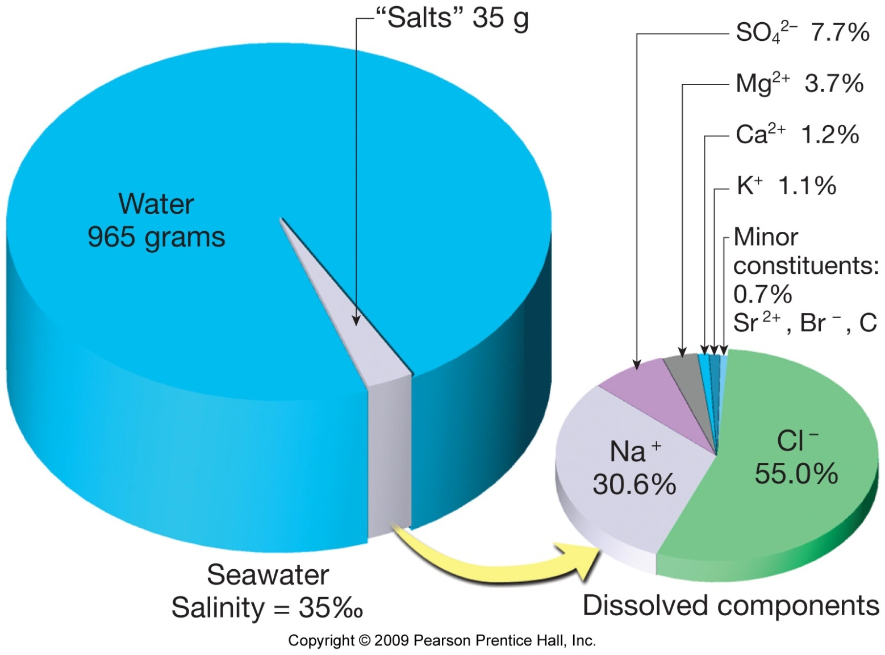
The amount of solid material dissolved in water

Slide 10
Source of salts?
Chemical weathering of rocks (dissolved load)
Volcanic activity: outgassing

Slide 11
Do you think salinity varies within ocean basins or is the same?
On the surface?
Within the basin?

Slide 12
What factors may change the salinity?

Slide 13
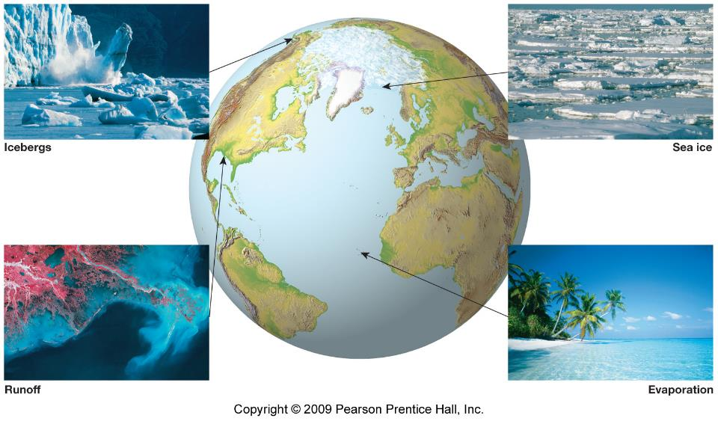
Precipitation

Slide 14
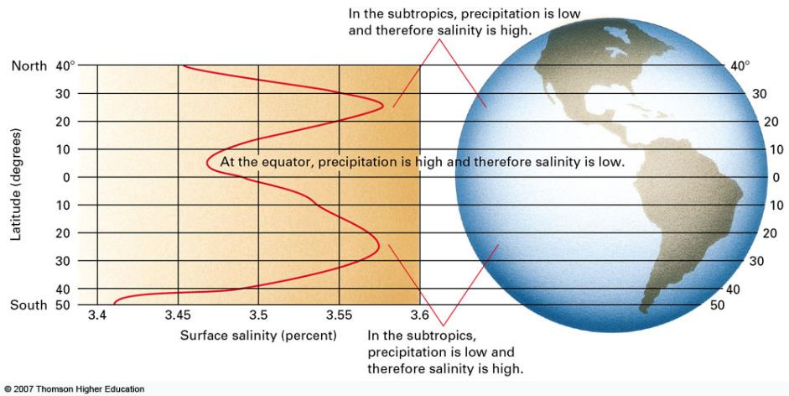
Fig. 16.4, p.402

Slide 15
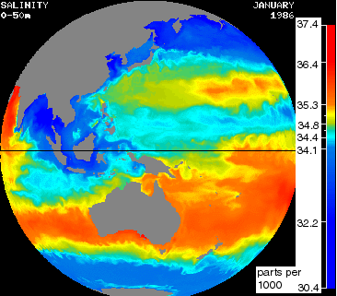
Salinity

Slide 16
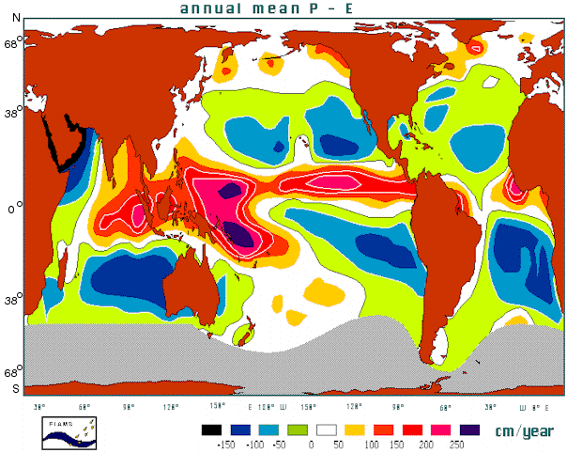
Precipitation and Evaporation
Red-precipitation
Blue-evaporation

Slide 17
Density: how heavy something is relative to its size
What factors change the density of sea water?
Temperature: increase, decreases density
Salinity: increase, increases density

Slide 18
Density determines the vertical position

Slide 19
Photic zone: where light penetrates; upper 600 ft or 200 m

Slide 20
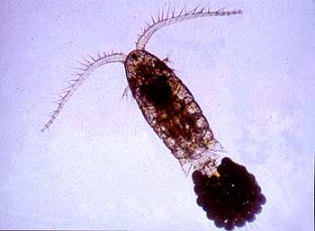
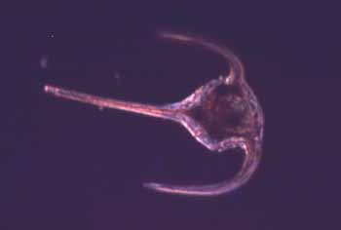
Plankton: microscopic animals and plants
Diatom-phytoplankton
bottom of the food chain
Use basic nutrients from sea water to produce skeletons and soft tissue
phytoplankton produce greater than 50%
Zooplankton
Copepod-1mm
Dinoflagellate- 250 microm.

