Slide 1
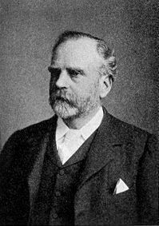
Content
• Introduction
• Stand Still Theory
• Criticisms
MURRAY
Source : google images

Slide 2
Introduction
• There is no dispute about the origin of fringing
coral reefs, but the base of barrier reefs and atolls
is sometimes at such a depth where it is not
possible for the coral polyps to survive. To solve
this problem, some theories have been given
about the origin of coral reefs, out of which three
theories have special recognition. These are –
• Land Subsidence Theory by Darwin
• Stand Still Theory by Murray &
• Glacial Control Theory by Daly

Slide 3
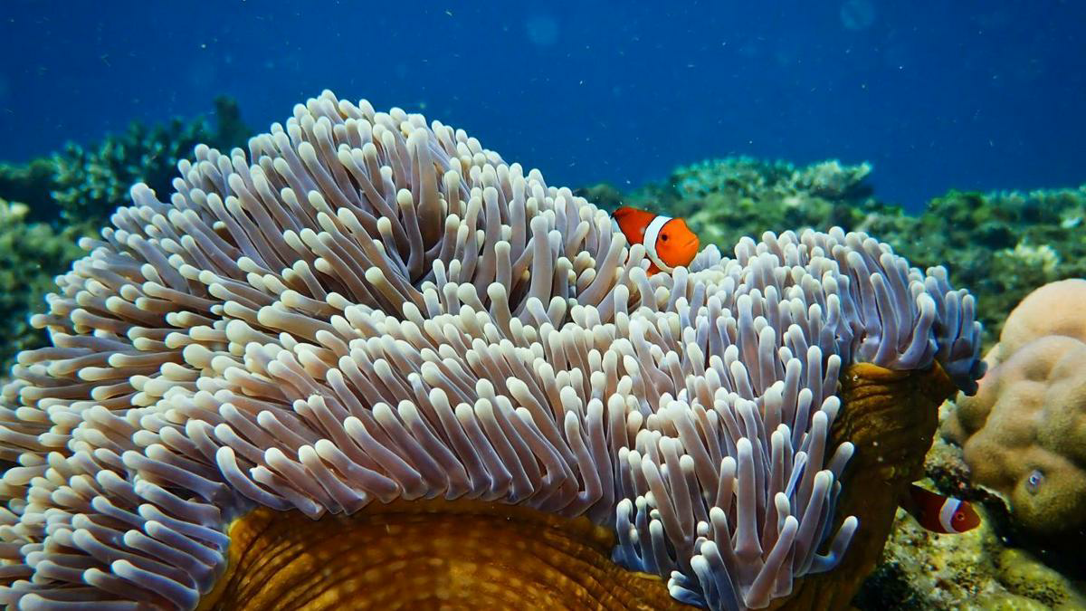
• The most widely recognised & accepted amongst the
three theories is the Land Subsidence Theory. It is
followed by the Glacial Control Theory & Stand Still
Theory respectively.
Source : google images

Slide 4
Stand Still Theory
• Murray propounded his theory of the formation of coral
reefs in the year 1880 on the basis of the information
received during the Challenger expedition (1872-76).
• According to Murray, the development of different types of
coral structure is based on the topography of shallow ocean
and the effect of lagoon water.
• This view has also been supported by thinkers such as
Sempler (1881) and Agassiz (1906).
• According to this theory, for the development of coral reefs
it is necessary to have sub-marine platforms whose depth
should not exceed 54-55 m.

Slide 5
• This suitable depth is obtained by two processes.
• If the sub-marine platforms are higher than this, they are
degraded by erosion & solution action and if they are
located below this depth, they are subjected to sub-marine
pelagic deposition and attain the required depth.
• Coral polyps develop on such platforms in large colonies
and together these colonies form the coral reef.
• Initially the reef develops in the form of fringing reef and its
lagoon is shallow.
• The coral polyps on the outer edge of the platform grows
relatively quickly.

Slide 6
• After some time, the coral reef extends beyond a depth of 54–
55 m, and after attaining this boundary, small pieces of coral
are broken down and deposited on the base of coral reefs.
Thus, without the subsidence of land the coral reef extends
into the deep ocean.
• The coral polyps living on this pile of debris makes its
development outward.
• On the other hand the coral polyps of the inner part of the
reef dies due to lack of food.
• The fresh water of the river flows into the lagoon of the
fringing reef.

Slide 7
• The water of the lagoon slowly begins to dissolve the lime-
dominated structure of the reef.
• When solution action begins in the lagoon, the lagoon begins
to deepen and the internal gradient of the coral structure
intensifies. In such a situation a barrier reef is developed.
• When the solution action becomes more intense, the depth of
the lagoon further increases and the internal gradient of the
coral structure becomes even more intense. This type of
feature is called an atoll.

Slide 8
• Regarding the construction of the atolls, Murray said
that they were built independently due to the circular
growth of coral polyps at the top of sub-marine
platforms and hills that are located at suitable depths.
• In this situation also, the coral polyps on the outer
edge of the reef develop at a rapid pace and soon
reach the surface to form the ring-shaped coral reef or
atoll within which a lagoon is formed.
• Dead coral on the side of the lagoon dissolves
continuously in the water, which causes the lagoon to
expand, but the outward development of the coral reef
continues which increases the size of the atoll i.e. its
thickness and width.

Slide 9
Criticisms
• According to this theory, for the construction of coral reefs,
innumerable sub-marine platforms & peaks should exist at
a depth of 54-55 m, which is not possible.
• According to this theory, the surface of the lagoon is the
result of solubility and the maximum depth of the coral reef
can be 54–55 m and the depth of the lagoon will not
exceed 54–55 m. This assumption does not apply in most
circumstances.
➢ Firstly, the soluble capacity of saline water of the sea is low.
➢ Second, there is evidence of deposition instead of soluble
chemical action at the bottom of the lagoon and

Slide 10
➢ Third, the depth of many lagoons is 100 m or more.
• It seems impossible to have both erosion and
deposition processes at the same depth.
• On the basis of these facts, this theory has been
almost rejected and at present it has only theoretical
and historical recognition.

