Slide 1
Origin of Earth -Theories
Dr. Swarnima Singh
Department of Geography
Assistant Professor
DDUGU, Gorakhpur

Slide 3
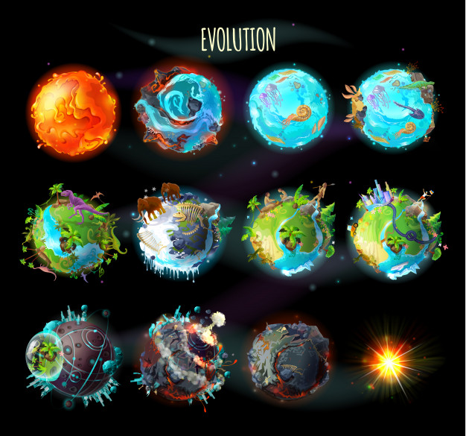

Slide 5
The Classical concept
The Scientific Concept:
The hot origin concept
The cold origin concept
The Recent Concept Division
Monistic concept
Dualistic concept
Binary star/ Trihybrid concept

Slide 6
Gaseous hypothesis of Kant
Nebular hypothesis of Laplace
Planetesimal hypothesis of Chamberlin
Jean and Jeffery’s tidal theory
Russel’s binary Star Hypothesis
Hoyle’s supernova hypothesis
Schmidt’s interstellar hypothesis
Big bang theory

Slide 7
1. Gaseous hypothesis of Kant
Nebula – It is a primordial (primitive) amorphous (without shape) mass of cloud of gas and dust.
The gaseous hypothesis of Kant was based on the sound principles of Newton’s law of gravitation and rotatory motion.
Assumptions
Due to mutual gravitational attraction and collision between the particles generated random motion in the primordial matter.
As a result, Particles will collide together and also generate friction which generates heat, with the result the temperature of the primordial matter started rising.
With the increase in temperature, the random motion as well as the rate of collision among the particles also increased. This gave extra momentum (driving force) of the rate of rotatory motion. The rise in temperature also changed the state of primordial matter from solid to gaseous particles. Thus, the original cold and motionless cloud of matter became in due course a vast hot nebula and started rotating around its axis.

Slide 8
According to Kant –
With a continuous rise in temperature and rate of rotatory motion, the nebula started expanding in size.
According to Immanuel Kant – As the heat increased, the size of nebula increased and as the size of nebula increased, the angular velocity or rotatory speed further increased.
Due to a continuous increase in the size of the nebula the rotatory speed became so fast that the centrifugal force (away from the center) exceeded the attractional or centripetal force (directed towards the center).
The nebula started spinning so rapidly that an irregular ring was separated from the middle part of the nebula and was ultimately thrown off due to centrifugal force.
By the repetition of the same process a system of concentric rings (nine) was separated from the nebula. The residual central mass of the nebula remained as the sun, and all the matters of each ring were aggregated at a point to form a core or a knot which ultimately grew as a planet in due course of time.
Gaseous hypothesis of Kant Supernaturally created primordial hard matter was scattered in the universe.
Nebula (Slowly rotating cloud of gas) and the matter was comprised of very cold, solid, and motionless particles.
Particles began to collide against each other under their mutual gravitational attractions.

Slide 10
Evaluation
According to Kant there was a primordial matter in the universe, but, he did not explain the source of the origin of the primordial matter.
Kant did not explain the source of energy to cause the random motion of the particles of the primordial matter which were cold and motionless in the initial stage.
The collision among the particles of the primordial matter can never generate rotatory motion in it. It is an erroneous statement of mechanism.
Kant assumes that the rotatory speed of the Nebula increased with the increase of its size was against the law of conservation of angular momentum.
However, the importance of Kant’s hypothesis lies in the fact that it was the first scientific attempt for the explanation of the origin of the earth. Kant’s hypothesis plays a great role in the postulation of the Nebular hypothesis by Laplace.

Slide 11
Nebular Hypothesis of Laplace
Laplace (French Mathematician) propounded his theory in 1796. Laplace’s nebular hypothesis was in some way similar to the Gaseous hypothesis of Kant and appears like the modified version of Kant’s hypothesis.
Assumptions
He assumed that there was a huge and hot gaseous nebula in the space.
From the very beginning huge and hot nebula was rotating on its axis.
The nebula was continuously cooling due to loss of heat from its outer surface through the process of radiation and thus it was continuously reduced in size due to contraction on cooling.

Slide 12
Nebulae: step 1
Gas (98%) and dust (2%)
Rotates and is held together by gravitational force

Slide 13
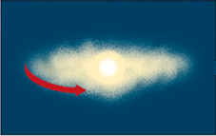
Step 2: The Nebula collapses
The collapsed mass forms a proto-sun due to gravitational force
Contraction increases speed of rotation: collapse

Slide 14
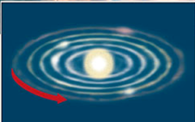
Step 3: sun is formed, disk cleared
The disk is “cleared out” due to the immense amount of energy released.
Sun is formed
Dust and gases cool and condense in defined orbits around the sun

Slide 15
According to Laplace
Since, Nebula was continuously reduced in size due to gradual loss of heat from the outer surface of the nebula through radiation.
Thus, Reduction in the size and volume of the nebula increased the circular velocity (rotatory motion) of the nebula.
Due to the increase in velocity, nebula started spinning at very fast speed and consequently the centrifugal force becomes so great that it exceeded the centripetal force.
Consequently, the Outer surface was condensed due to excessive cooling and so it could not rotate with the still cooling and contracting the central nucleus of the nebula.
And, Thus the outer ring was separated from the remaining part of the nebula.
And this separated ring started moving around the nebula.
Laplace further maintained that the original ring was divided into nine rings and each ring moved away from the outer ring.
Thus, nine planets were formed from the nine rings and the remaining central nucleus of the nebula become the Sun.

Slide 16
Evaluations
He did not describe the source of the origin of the nebula.
He did not explain that, why did only 9 rings come out from irregular ring detached from the nebula?
If the sun is the remaining nucleus of the nebula as claimed Laplace, it should have a small bulge around its middle part which would point out the probable separation of the irregular ring from the sun but there is no such bulge in the middle part of the sun.
According to the nebular hypothesis all satellites should revolve in the direction of father planets but few satellites of Saturn and Jupiter revolve in the opposite direction of their father planets.
The nebular hypothesis is unable to explain the peculiar distribution of present-day angular momentum in our solar system.
Outcome: The merit of the theory lies in the fact that it is the most acceptable explanation in explaining the layered structure of the earth’s interior.

Slide 17
3. The planetesimal hypothesis of Chamberlin (1905)
The planetesimal hypothesis of Chamberlin belongs to the dualistic concepts of the origin of the Earth.
According to Chamberlin initially there were two heavenly bodies (stars) in the universe –
Proto-Sun and its Companion Star or Intruding star
The behavior and properties of proto-sun were not like other stars, It was formed of very small particles which were cold and solid.
Theory: When the intruding star came very close to the the Proto-Sun infinite number of small particles were detached from the outer surface of proto-sun due to massive gravitational pull exerted by the giant intruding star. This matter which is dust, gases, rock fragments eventually accrete forming planets & other celestial bodies that revolve around the proto sun.

Slide 18
Dualistic Hypothesis

Slide 19
Planetesimal hypothesis not only explains the origin of the earth but also throws light on the structure of the earth, the origin of its atmosphere and continents and ocean basins.

Slide 20
This theory is the best interpretation in explaining the sizes of the planets as they have arranged themselves away from the sun.

Slide 21
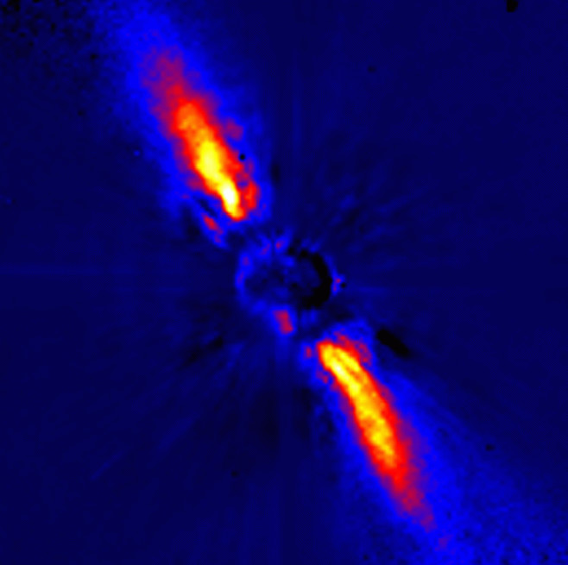
Beta Pictoris is a young star about 20 million years old that is located 63 light years away.
The Beta Pictoris disk appears to be a young planetary system in the making. This image supports the standard model of solar system birth, which supposes that planets accrete from a disk of dust and gas surrounding a young star.
Beta Pictoris
This false-color image of the disk surrounding Beta Pictoris was obtained at the European Southern Observatory by blocking direct starlight and imaging the near-infrared light from the disk.

Slide 22
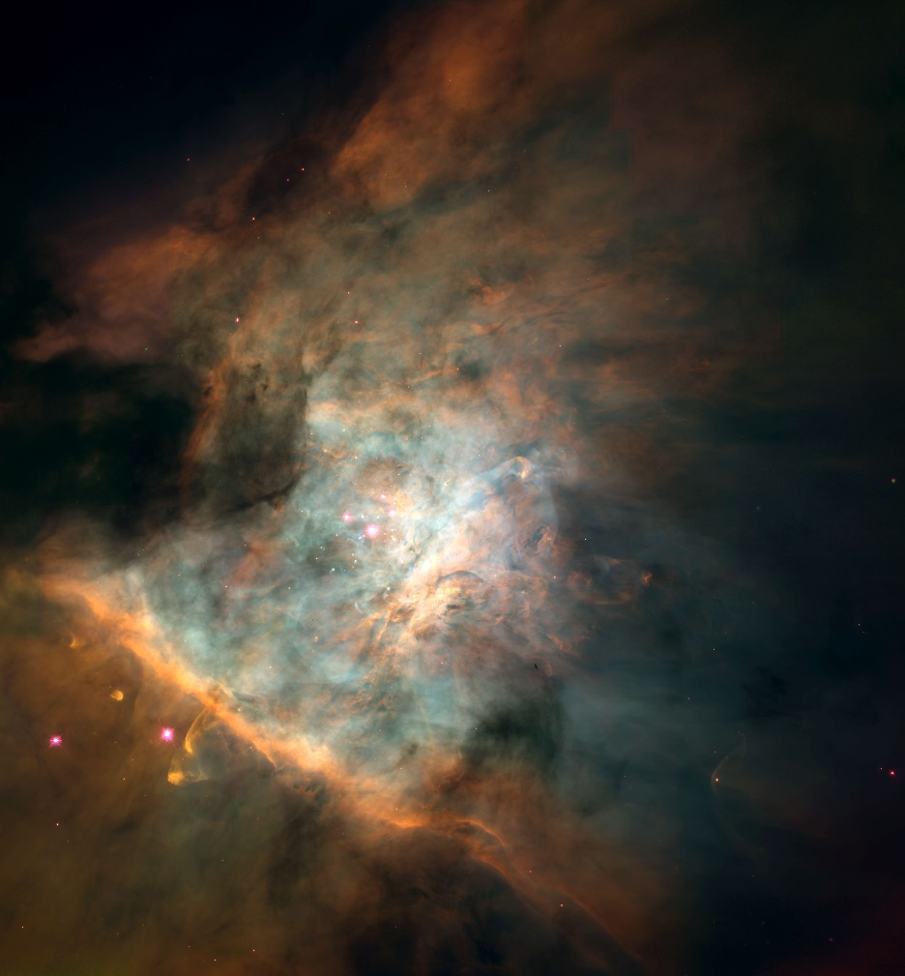
At the heart of the Orion Nebula lies a complex of molecular clouds where abundant star formation is occurring today.
The clouds are illuminated by a flood of ultraviolet light emitted by four bright stars, collectively called the Trapezium.
More than 150 protoplanetary disks have been found in this mosaic of HST images.
Orion Nebula, giant stellar nursery ~1600 light years away

Slide 23
5. Russel’s binary Star Hypothesis
There is a binary star system (two stars coupled together and rotating around a fixed center of mass).
The intruding star comes close to the binary stars & eject matter from one of the stars. (It doesn’t explain what happened to the intruding star and the remainant of the star from which matter got ejected.)
The ejected matter circulates into planets and revolves around the proto sun.
This theory is convenient to explain why the composition of planets is different from the sun.

Slide 24
6. Hoyle’s supernova hypothesis
According to Hoyle initially there were two stars in the universe –
(1.)Primitive Sun and (2.) Companion star
The companion star was giant and later on became supernova due to nuclear reaction.
Over time, all of the hydrogen nuclei of companion star were consumed in the process of nuclear reaction and it collapsed and violently exploded
The Violent explosion of companion star resulted in the spread of enormous mass of dust which started revolving around the primitive sun in the form of a circular disc
The matter of this disc became building material for the formation of the future of planets.

Slide 25
Supernova

Slide 26
Thus, the planets of our solar system were formed due to condensation of the matter of the disc.

Slide 27
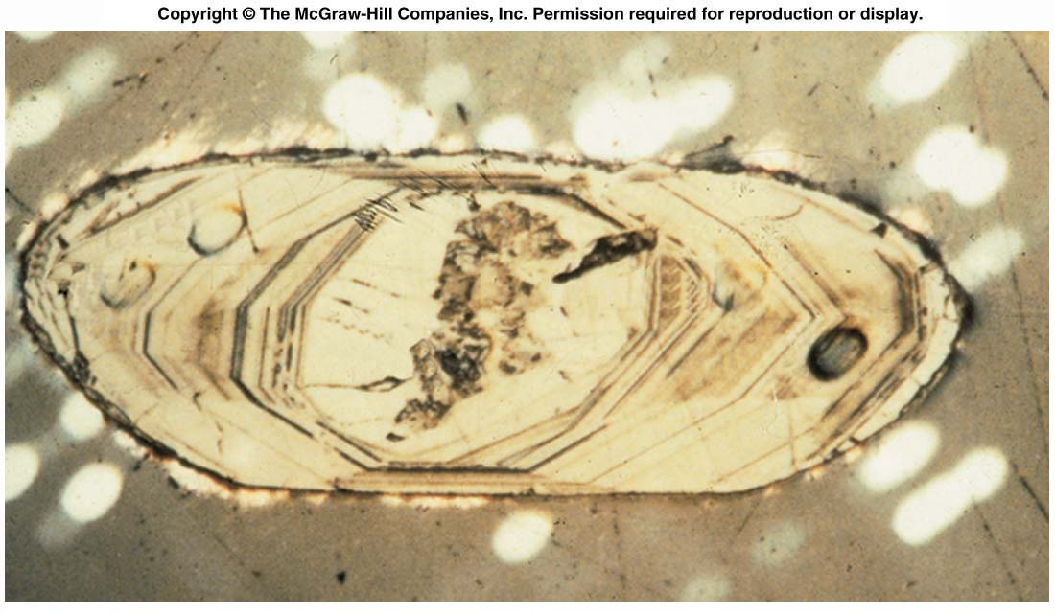
Fig. 6.12a
Zircon grain from the Acasta Gneiss, Slave Province, NW Territories, Canada. The crystal has been etched with acid to highlight the growth zones. These zircons have been dated to 4.03 By.

Slide 28
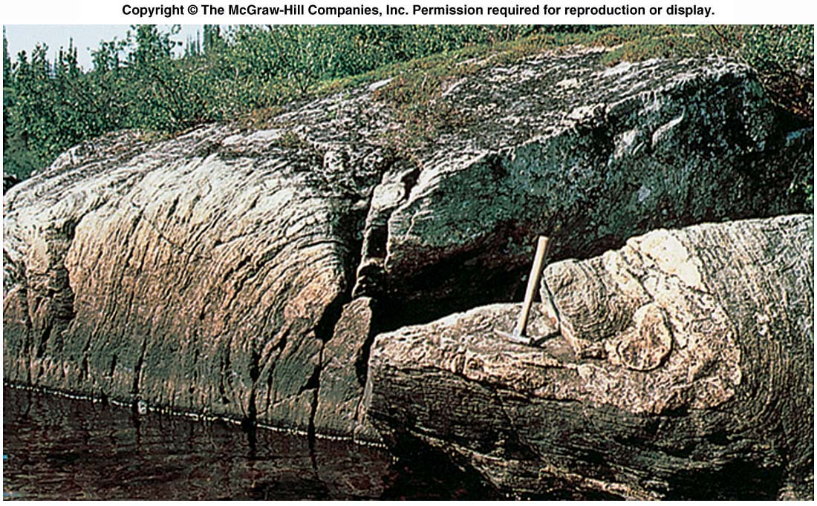
Fig. 6.12b
The Acasta Gneiss. Great Slave Province, NW Territories, Canada. One of the oldest (4.03 Bya) dated rocks on Earth. This must have been one of the first crustal rocks to form either at Late Hadean or shortly thereafter.

Slide 29
7. Schmidt’s interstellar hypothesis
According to this theory, the initial universe comprised of stars & randomly distributed matter filling up the space in between.
According to Schimidt, this dark matter, started to revolve around the primitive rotating sun and gradually the dark matter stars accreting & condensing & thus forming the solar system.
Though Schimidt did not explain the mode of origin of these dark matters. These dark matters were called ‘inter-stellar dusts’ by Schmidt.
This theory may be considered as explaining the processes that preceded the Nebular accretionary process of Laplace & Kant.

Slide 31
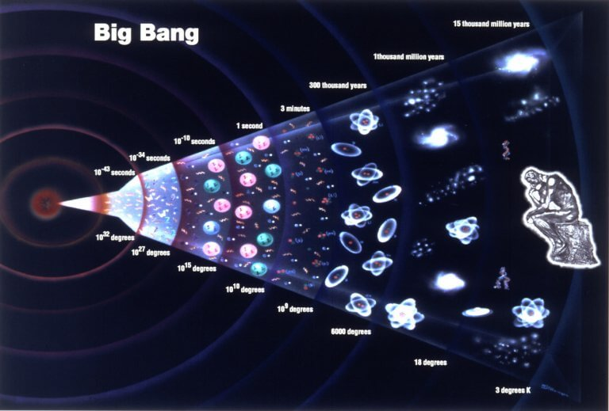
8. BIG BANG THEORY
Big Bang theory’s idea was first given by George Le Naitre in the 1920s & was gradually contributed by many scientists. But an important role was played by Gamenov (1970’s).
According to this theory, Everything in the universe has emerged from a point known as the singularity, 15 billion years ago.

Slide 32
Big Bang Theory (Expanding Universe Hypothesis)
It explains the origin of Universe. On witnessing that Galaxies move far from each other, Universal expansion is proved by Sir Edwin Hubble in 1920. For example if we take the balloon and mark some points on it, now blow the balloon we can clearly see the inflation leads to stretching of points. Big bang theory can be explained in three developmental stages: • At first tiny ball with small volume as an atom, which had infinite mass and temperature • A violent explosion of tiny ball happened which resulted in huge expansion. change of some particles into energy form. Due to this expansion, some energy got converted to matter. This happened before 13.7 billion years from our present day. • Then temperature dropped to 4,500K after 300,000 years of explosion, atomic matter is formed and universe become transparent

