Slide 1
Function of Ecosystems

Slide 2
Function of Ecosystems
Function depends upon Energy Flow
It helps distribution and transportation of Living and non Living
Unidirectional Path
But, Transfer of energy follows unidirectional path
and Matter is in cyclic pattern.
The energy pattern and flow are governed by 1st and 2nd law of Thermodynamic
Format and Flow of Energy depends up on first and second law of Thermodynamics:
First law: Law of Conservation of Energy
In any system of constant mass, energy is neither created nor destroyed but it can be transformed form one type to another type.
Second Law: Law of Dispersion or Dissipation
when work is done, energy is dissipated and the work id done when one form of energy is transformed into another form.

Slide 3
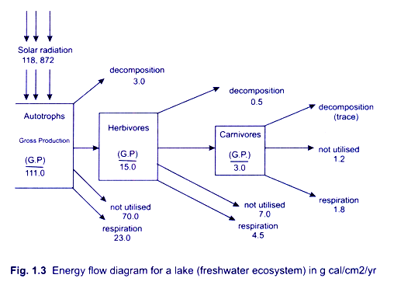
Energy Transfer in Ecosystem
Apart from the energy released to the atmosphere through respiration, the remaining energy ‘is transferred in successive consumer stages known as trophic levels from autotrophs to heterotophs. Ultimately all the energy is passed on the detrivores, or decomposer organisms.

Slide 4
Major Categories elements of Ecosystem
Macro Elements: Oxygen, Carbon and Hydrogen
Minor or Micro-Elements: Nitrogen, Phosphorus, Potassium, Calcium, Magnesium and Sulphur.
Trace elements: Iron, Zinc, Manganese and Cobalt .
Organic Element
Decomposed parts of either alive or dead plants and animals
Waste materials released by animals (hydrogen, oxygen and nitrogen in Gaseous phase/ Phosphate, calcium or sulphur in sedimentary phase)

Slide 5
Flow of Nutrients in Ecosystem
Atmospheric phase
Sedimentary reservoirs
Root osmosis
Uptake of nutrient from soil.
Use in biogeochemical process
Nutrients passes into various components of biotic communities –in biogeochemical cycles.

