Slide 1
Climatic Changes
due to
Environmental Pollution

Slide 2
Definition of Pollution
When Harmful Substances Contaminate the environment it is Called Pollution.
It can be defined as:
“Any undesirable change in the physical, chemical, biological characteristics of any component of the environment which can cause harm to life and property.”

Slide 3
WHAT IS CLIMATE CHANGE?
Weather reflects short term conditions of the atmosphere, it can change from minute-to-minute, hour-to-hour, day-to-day and season-to-season. Climate is the average of weather over time and space.
Unlike “weather,” which means temperature, rainfall, humidity of a particular time at a local area, “climate” has spatial and temporal components.
It consists of many kinds of weather events, their periodicities, intensities, and nature of dynamism.
When we talk about climate change, we actually understand more than the literal changes of weather events over the time and space of that climate.
“The scientific evidence is now overwhelming: climate change presents very serious global risks, and it demands an urgent global response.” Stern Review, 2006

Slide 4
Types of Pollution
Pollution
Air
Thermal
Nuclear
Soil
Noise
Water
Marine

Slide 5
Association between Environmental Pollution and Climate Change
Type | Pollution | Change
Air | Green House Gas | Global Warming
Air/water | Thermal Pollution | Global Warming
water | Co2 level rise | Global warming
water | Oxygen reduce | Biodiversity loss
Land | Solid waste
Land | Soil moisture loss

Slide 6
A. Air Pollution and Climate Change

Slide 7
Major Air Pollutants
Air pollutants may be particulate or gaseous.
On the basis of origin they are divided as
Primary pollutants ---- Are emitted directly from the point source. e.g. : PM, CO₂, CO, NO₂, SO₂
Secondary pollutants ---- formed by interaction of primary pollutants
e.g. : PAN, Smog, Ozone etc

Slide 8
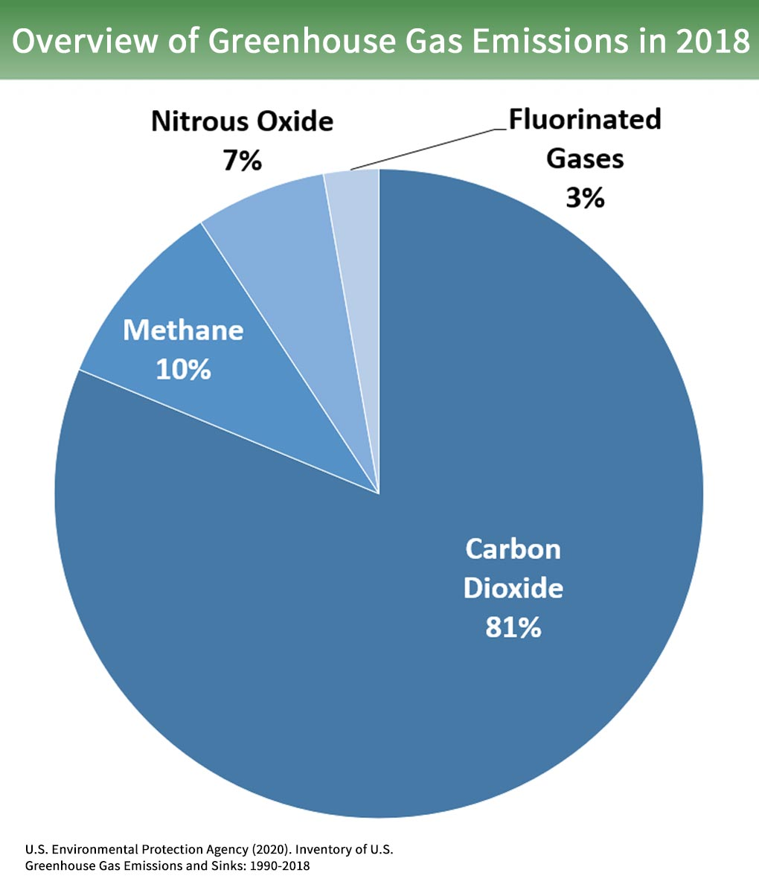
Role of CO₂ and Greenhouse Gas Emissions on climate change
The Intergovernmental Panel on Climate Change (IPCC) states clearly in its most recent assessment report (AR5)⁴:
“Anthropogenic greenhouse gas emissions have increased since the pre-industrial era, driven largely by economic and population growth, and are now higher than ever. This has led to atmospheric concentrations of carbon dioxide, methane and nitrous oxide that are unprecedented in at least the last 800,000 years. Their effects, together with those of other anthropogenic drivers, have been detected throughout the climate system and are extremely likely to have been the dominant cause of the observed warming since the mid-20th century.“

Slide 9
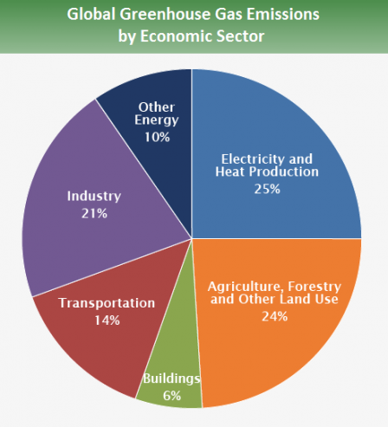
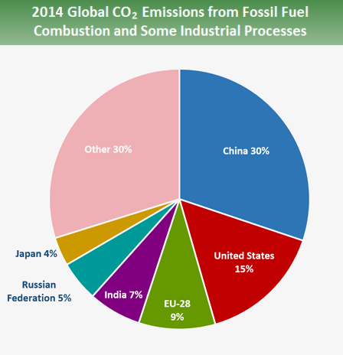

Slide 10
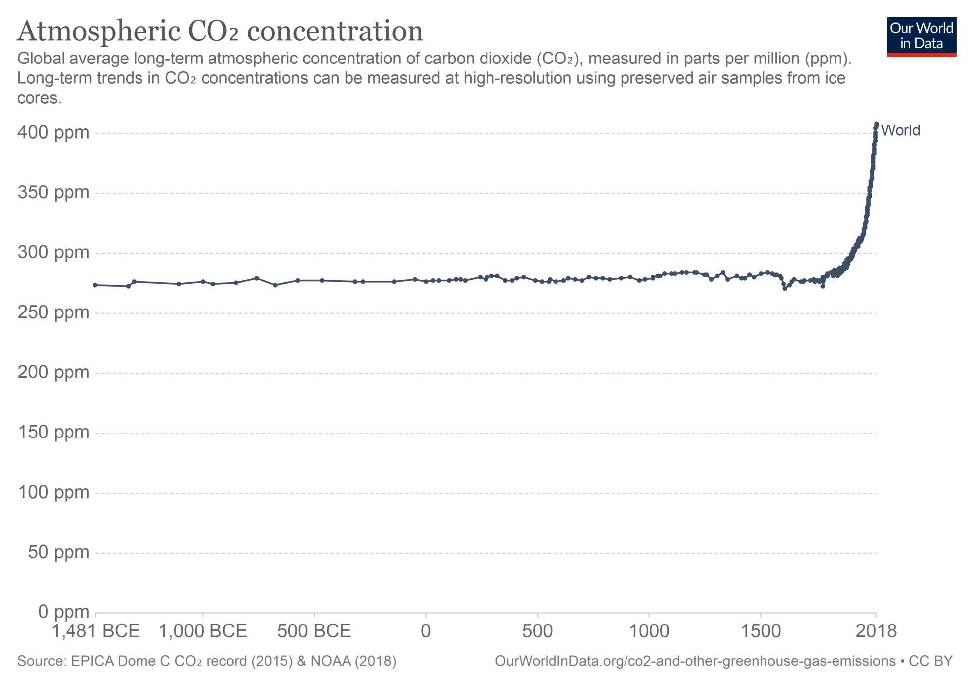

Slide 11
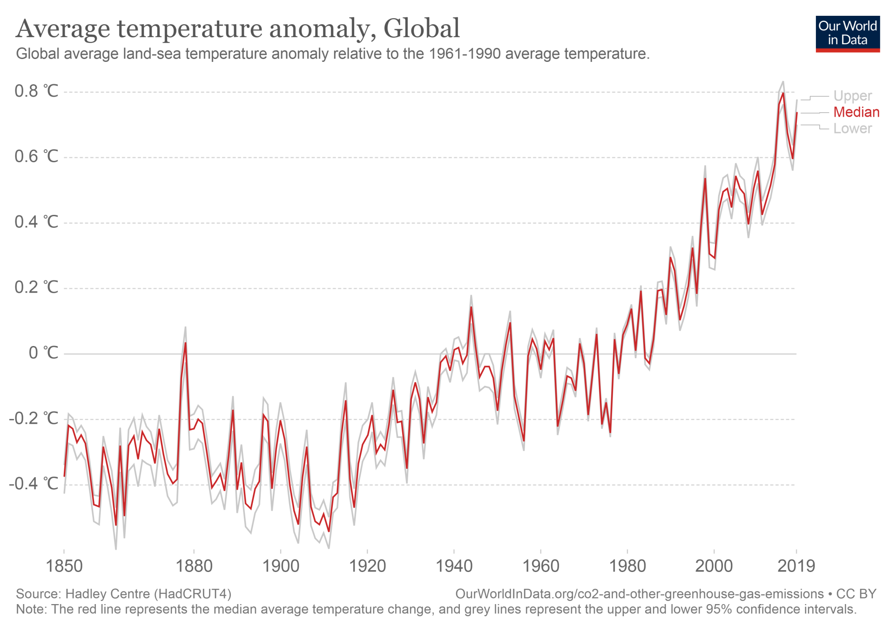

Slide 12
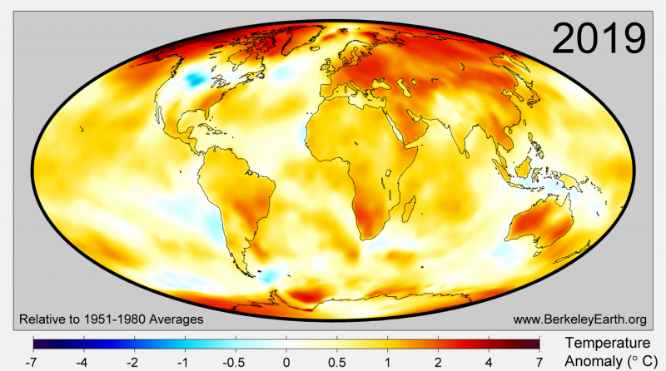
A changing climate has a range of potential ecological, physical and health impacts, including extreme weather events (such as floods, droughts, storms, and heatwaves); sea-level rise; altered crop growth; and disrupted water systems. The most extensive source of analysis on the potential impacts of climatic change can be found in the 5th Intergovernmental Panel on Climate Change (IPCC) report.⁵

Slide 13
Regional climate effects of aerosols
Present GCMs indicate that aerosols (may) influence local climate
Sulfates:
Cooling effect
Changes in precipitation observed in China related to increase in China’s SO₂?
Did European SO₂ affect precipitation in Africa (Sahel)?
Black carbon:
Warming effect
Issue for bio-fuels
Organic carbon:
Cooling effect
Net effect of PM from different sources?

Slide 14
B. Water Pollution and Climate Change
Water pollution and ocean water Property Change
Changes in water temperature,
Ocean acidification : Our oceans are absorbing carbon dioxide, rapidly causing them to become more acidic. This is threatening the habitat of every species
Deoxygenation: Ocean deoxygenation is the reduction of the oxygen content of the oceans due to human activities as a consequence of anthropogenic emissions of carbon dioxide and eutrophication driven excess production.
leading to changes in climatic property
Oceanic circulation and chemistry,
Rising sea levels,
increased storm intensity,
changes in the diversity and abundance of marine species.

Slide 15
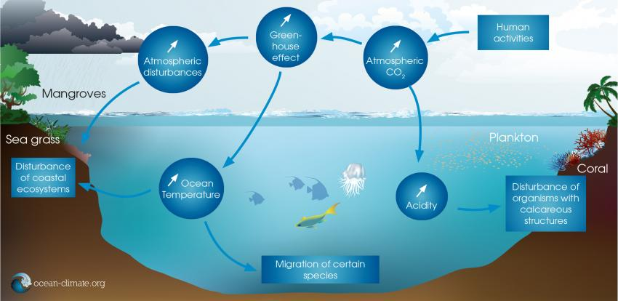

Slide 16
C. Land Pollution and Climate Change
This emerges from a natural circulation, in turn, land pollution leads to the deforestation, it leads to less rain, eventually to problems such as the greenhouse effect and global warming/climate change.

Slide 17
C. Thermal Pollution and Climate Change

