Slide 1
Composition and Structure
of Atmosphere

Slide 2
Composition of the Atmosphere Permanent constituents
Gases that remain essentially constant by percent: Nitrogen, Oxygen, Argon, Neon, Helium, Krypton, Hydrogen Variable constituents
Gases that have changing concentrations over a finite time: Water vapour, Carbon dioxide, Methane, Ozone, etc.
Water vapor is < 0.25% in the atmosphere – decreases with elevation - surface values vary (<<1% in desserts, 4% in tropics, 1- 2% in mid-latitudes) – found only in lower altitudes
CO₂ level 390 ppm (mass) and growing
Ozone concentration near the surface is about 0.04-0.15 ppm, and it can reach 15 ppm in the upper atmosphere
Aerosols: Dust, smoke, ash, pollen, microbes, sea-spray or salt, water droplets, ice crystals, H₂SO₄, etc.

Slide 3
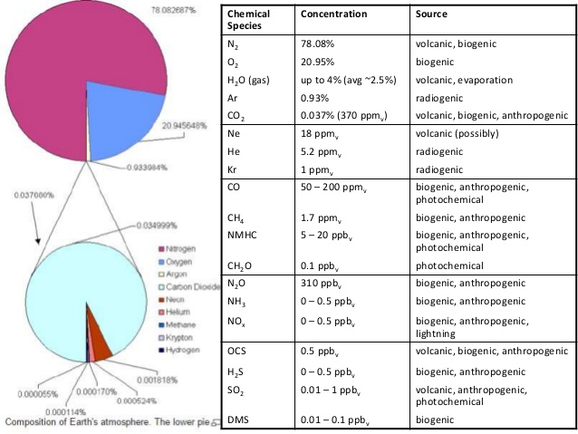

Slide 4
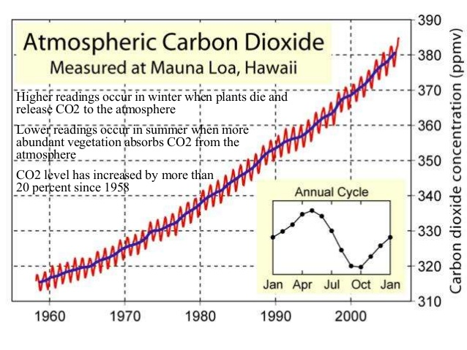

Slide 5
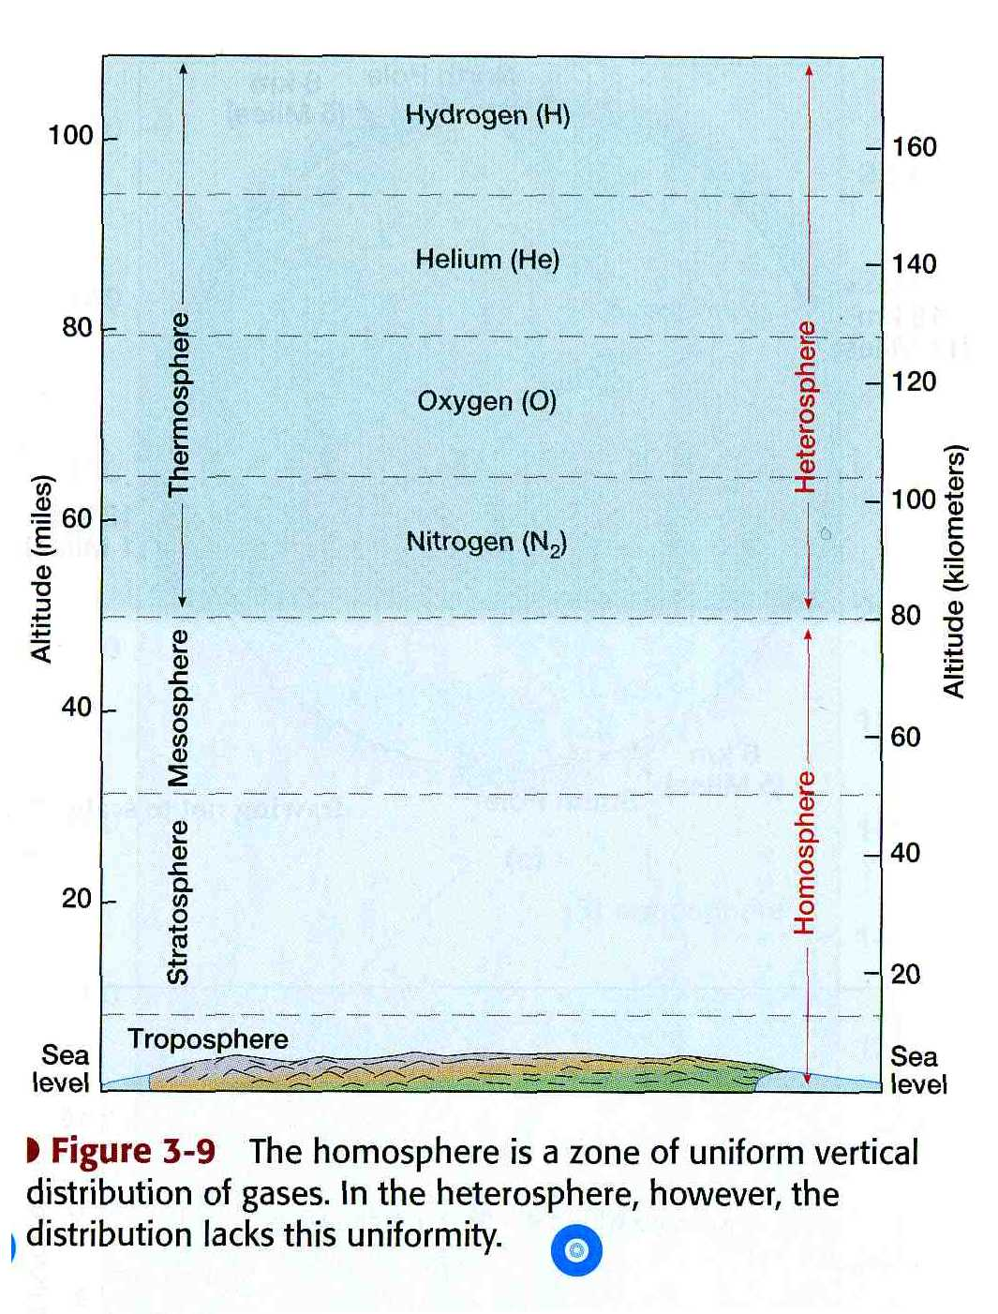
Composition and Structure
Divisible into Homosphere and Heterosphere
• Homosphere
Troposphere, stratosphere and mesosphere together constitute the homosphere
Upto 80 - 100 kM altitude
Turbulent mixing: solar radiation accelerates atoms/molecules
collision of atoms/molecules even out the energy distribution
• Heterosphere:
Beyond 80 kM altitude
Gases are stratified -heavier molecules (N2, O2) are at lower altitude and lighter ones (H2, He) at higher altitude)
Atoms/molecules are accelerated by solar radiation due to rarity, they rarely collide instead they fly higher and even escape
At the top, the atoms behave like ballistic objects their velocity often exceeds escape velocity (11 kM/sec.) and escape into space
Troposphere, stratosphere, mesosphere and thermosphere layers are identifiable in the atmosphere
Tropopause, Stratopause and Mesopause between the layers
Exosphere and Ionosphere often identified within thermosphere

Slide 6
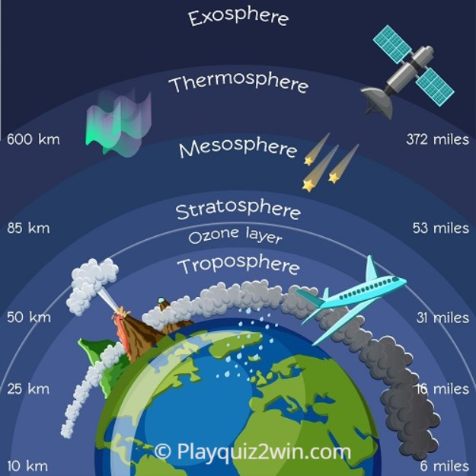
Atmospheric layers:
The Kármán line is the altitude where space begins. It is 100 km (about 62 miles) high. It commonly represents the border between the Earth's atmosphere and outer space. This definition is accepted by the Fédération Aéronautique Internationale (FAI).
Karman line

Slide 7
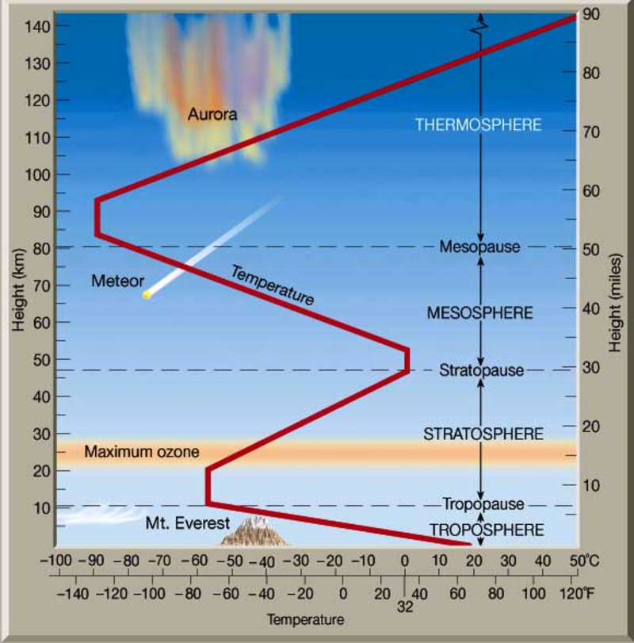
Atmospheric layers:
1. Troposphere
(Teisserenc de Bort )
Thickness is Varies – 18-20 kM at the equator and 6-7 kM at poles - variation can also be due to weather – The bottom 1-3 kM layer of the troposphere is differentiated as Planetary boundary layer (PBL) – here mixing occurs rapidly
Contains roughly 80% of the total atmospheric mass and almost all the water vapour – all weather phenomena are limited to this layer
Troposphere is mostly heated by heat transfer from the earth surface and with altitude temperature decreases from 17°C to -51°C – Temperature lapse (6.4C/kM) promotes vertical mixing and cause the weather phenomena to occur in this region
With altitude, in addition to temperature lapse, air density decreases (air becomes thinner) and air pressure also drops
Tropopause is transition boundary between troposphere and stratosphere – Temp. lapse rate is <2C/kM while in troposphere it is 6.4C/kM
Troposphere, together with tropopause, is considered as lower atmosphere

Slide 8
Atmospheric layers:
2. Stratosphere
Layer above the troposphere - extends from 6-20 kM to 50-55 kM
It holds 19% of the atmosphere's gases - contains the stratospheric ozone – contains very little of water vapor
Temperature increases with height as UV radiation is increasingly absorbed (Oxygen-Ozone chemistry) – Absorption of solar radiation makes ozone and ozone absorbs solar UV radiation – temperature rises from -60°C at tropopause to -15°C at the stratopause – No convection occurs and there is no vertical movement of gases - fairly stagnant layer
Stratopause – a transition boundary separating stratosphere from mesosphere - at 50-55 kM altitude - pressure is 1/1000th of MSL
Of the four layers, troposphere and stratosphere are relevant and important - weather phenomena and climate are mostly influenced by these - human beings is affected by only these two layers

Slide 9
Atmospheric layers:
3. Mesosphere
Extends from 50–55 kM to 80–85 kM altitude
Gases (including O₂) become thinner and thinner with height, but the gases are still thick enough to slow down the meteorites and burn them up, leaving fiery trails in night sky – Only 0.1% of the atmosphere is in this layer and above
Warming by UV radiation becomes less and less with increasing altitude, and temperature in this layer decreases with altitude from -15°C to - 95°C
Mesopause (a transition boundary between mesosphere and thermosphere) is the coldest place on Earth (around -95C temperature)
Due to the cold temperature of the mesosphere, water vapor is frozen - forms ice clouds (Noctilucent clouds)
The stratosphere and the mesosphere, along with the stratopause and mesopause, are called the middle atmosphere

Slide 10
Atmospheric layers:
4. Thermosphere
Extends from 80–85 kM to 690 kM altitude and is known as the upper atmosphere
Gases here are increasingly thinner than in the mesosphere, and this layer is warmed by atoms being accelerated by solar radiation – Absorption of incoming high energy UV and X-ray radiation, mainly by oxygen, causes a large temperature increase – reaches 1500C - 2000C near the top – Because of the extremely thin air, despite the high temperature, this layer of the atmosphere holds very little heat and feels very cold
Most small meteorites burn up in this layer and Northern Lights (Aurora Boreolis) occur in this layer
The International Space Station orbits in this layer, between 320 and 380 km
Top of this layer is often considered as the bottom of the exosphere (exobase) – Height of the Exobase varies with solar activity and ranges between 350–800 km

Slide 11
Atmospheric layers:
Ionosphere and Exosphere Ionosphere
Located mostly in the thermosphere and extends from 60 KM to 300 KM altitude
May overlaps all the top three layers of the atmosphere (stratosphere, mesosphere and thermosphere).
Made of electrically charged (ionized) gas particles – has significant concentration of ions and electrons
Enables bouncing of radio waves Exosphere
Outermost layer of the atmosphere, and extends from the exobase/thermopause (690 km to 10,000 km)
Mainly composed of hydrogen and helium
The particles in this layer are so far apart that they travel long distances without colliding (atmosphere no longer behaves like fluid) – The particles follow ballistic trajectories and escape out into the space

Slide 12
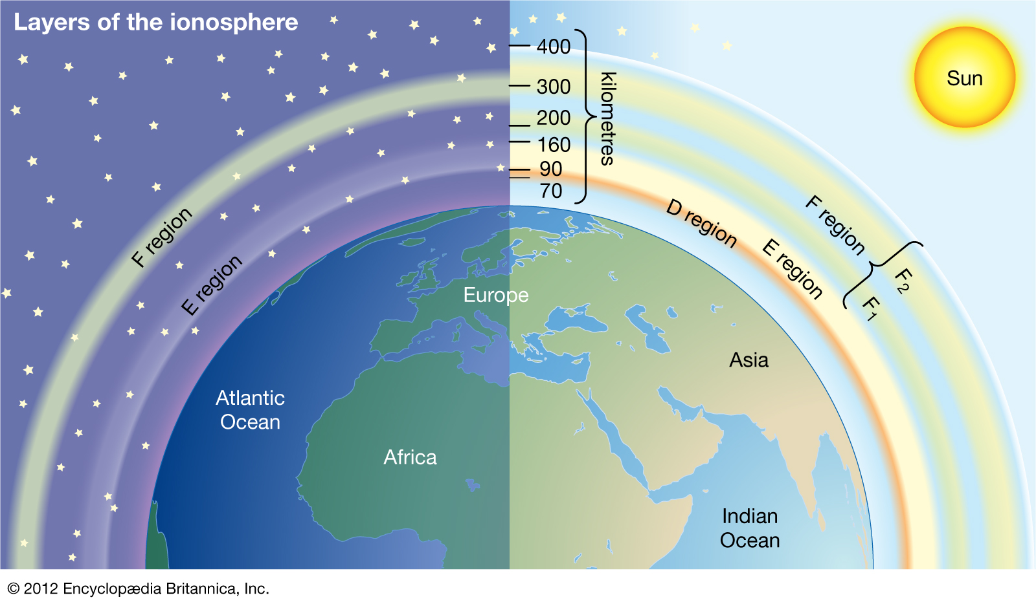
Layer of Ionosphere

Slide 13
Reference:
Internet sources
Savindra Singh (2011) Climatology, Prayag Pustak bhawan., Allahabad.
Savindra Singh (2015) Physical Geography, Prayag Pustak bhawan., Allahabad.
Websites: https://www.pmfias.com
YouTube: https://www.youtube.com/c/poormansfriend
Costas G. Helmis l Panagiotis T. Nastos Editors (2012) Advances in Meteorology, Climatology and Atmospheric Physics. Springer, New York.
Rachita G., Climatology: Development, Division and Climatic Data. Available at https:// www. Your article library. com/ climatology/ climatology-develo -pment –division -and-climatic-data/88757, accessed on 27-05-21.
Thank you

