Slide 1
B.Sc. II Year, Zoology Paper II- Vertibrate Zoology
Digestive System of Uromastix hardwickii
Dr. S. K. Tiwari
Department of Zoology
DDU Gorakhpur University, Gorakhpur-273009

Slide 2
Digestive System of Uromastix hardwicki
The digestive system of Uromastix hardwickii (spiny tailed lizard) consists of-
(A) Alimentary canal, and
(B) Associated digestive glands
(A) Alimentary canal : It is a long and convoluted canal beginning from mouth and terminating into cloacal aperture. It may be differentiated into following parts-
(i) Mouth
(ii) Buccal cavity
(iii) Pharynx
(iv) Oesophagus
(v) Stomach
(vi) Small intestine
(vii) Large intestine and
(viii) Cloaca

Slide 3
(i) Mouth –
• Slit like opening bordered by upper and lower jaws
• Each jaw is covered by fleshy immovable lips
• Both lips are covered with horny scales • Mouth opens into Buccal cavity
(ii) Buccal cavity –
• Buccal cavity is provided with roughly triangular, well developed muscular tongue on its floor
• The tongue is long, bifid and protrusible with taste buds and mucous glands
• In the upper jaw the teeth are present on the Premaxillae and maxillae
• In the lower jaw the teeth are present on the palatines and pterygoids
• The teeth are Acrodont • Internal nares present on the roof of buccal cavity near the anterior end

Slide 4
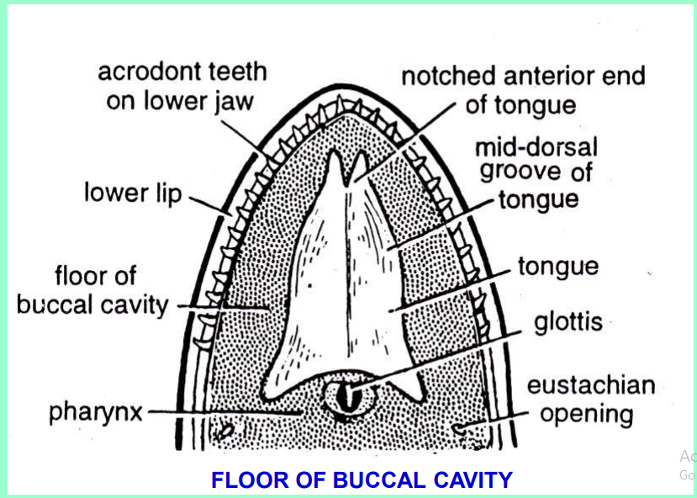

Slide 5
(iii) Pharynx –
• Pharynx lies posterior to the tongue
• The floor of the pharynx carries a longitudinal slit, the glottis, which leads to trachea
• On either side, opens a small rounded aperture of eustachian tube
• Pharynx lead into oesophagus through gullet
(iv) Oesophagus –
• It is long, narrow, cylindrical tube
• It is capable of great distension
• It leads into wide cylindrical stomach
• Numerous longitudinal folds present on the entire inner surface of the oesophagus

Slide 6
(v) Stomach :
• It is long, cyclindrical and curved sac–like structure with thick muscular wall
• Lies on the left side in the body cavity
• Stomach is differentiated into two parts –
• (a) anterior part is known as cardiac stomach
• (b) posterior part is known as pyloric stomach
• Liver is attached to the stomach by a thin fold called a hepatic omentum
• The pyloric valve is in the form of muscular ring which lies on the posterior extremity of pyloric stomach

Slide 7
(vi) Small Intestine :
• It is long, narrow and coiled tube
• It comprises an anterior duodenum and posterior ileum
• Duodenum is U – shaped and receives the bile and pancreatic ducts
• Between the two limbs of U, pancreas is present
• Ileum is the longest part of digestive tract attached to the dorsal body wall by the dorsal mesentery
• Inner surface of duodenum and ileum is raised into longitudinal folds of mucosa
• Folds increase the arc of secretion and absorption

Slide 8
(vii) Large Intestine
• The large intestine consists of a proximal colon and a distal rectum
• A blind pouch, the caecum, arises from the junction of the ileum and colon
• An ilio-colic valve is present internally at the junction of ileum and caecum
• The function of colon is the formation of faeces and absorption of water
• Rectum is short, tubular and thick walled and serves to store the faeces
• The rectum leads behind into the cloaca

Slide 9
(viii) Cloaca –
• Cloaca is internally divided into three chambers
• The anterior chamber is coprodaeum which receives the rectum
• The middle chamber is urodaeum which receives the ureters and the gonoducts dorsally and the urinary bladdder ventrally
• The posterior chamber is proctodaeum opens to the outside by cloacal aperture
• Cloacal aperture is transverse slit present at the junction of trunk and tail on the venture surface
• Cloaca serves for the reabsorption of water from faeces and urine

Slide 10
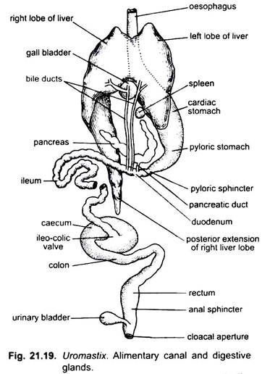

Slide 11
(B) Associated digestive glands :
Associated digestive glands are gastric glands, liver, pancreas and Intestinal glands
Gastric Glands –
• Microscopic, simple or branched, the glands secrete gastric juice into the cavity of stomach.
2. Liver –
• It is large , bilobed and dark brownish red gland, situated a little posterior the heart between the lungs
• It is connected with the stomach by a thin membranous fold, the gastrohepatic omentum

Slide 12
• The liver consists of three lobes : right, left and dorsal
• The right lobe is long and narrow and its posterior end reaching up to the right gonad
• The left lobe is short and broad lying ventral to the stomach
• The dorsal lobe is small, found attached to the dorsal side of the left lobe
• The liver secretes bile which is stored into the gall bladder
• The gall bladder is situated at the junction between the left and the right lobes
• A cystic duct arising from the gall bladder and a hepatic duct arising from the right lobe of the liver joint to form first bile duct to open into the duodenum
• A second bile duct originates from the left lobe of the liver and opens into the duodenum independently

Slide 13
3. Pancreas –
• Pancreas is white, elongated and narrow gland situated along the pyloric stomach in the loop between duodenum and the stomach
• Pancreatic duct originates from the posterior end of the pancreas and opens into the duodenum
• The pancreas secretes the pancreatic juice
4. Intestinal glands –
• These glands are found in the mucosa of the small intestine
• The glands are numerous, microscopic and invisible
• Glands secretes intestinal juice into the lumen of small intestine

